Slide 1
Food Venues Analysis in Tunis and Vienna
IBM DataScience Capstone project
By : Hassen Harzallah
May 2020

Slide 2
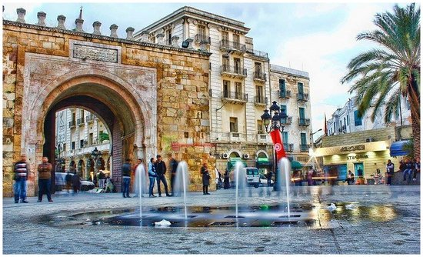
Introduction
Use datascience skills to answer the following questions :
Which city provides easier access to food ?
In which city, a new food store has less competitors ?
Where in the city, one should launch his food business ?

Slide 3
Methodology
Import Data: use Foursquare API + Geopy
Clean Dataset: normalize JSON and make a pandas data frame
Visualize Data: use Folium to create maps
Clustering: calculate optimal number of clusters then clustering using Sklearn

Slide 4
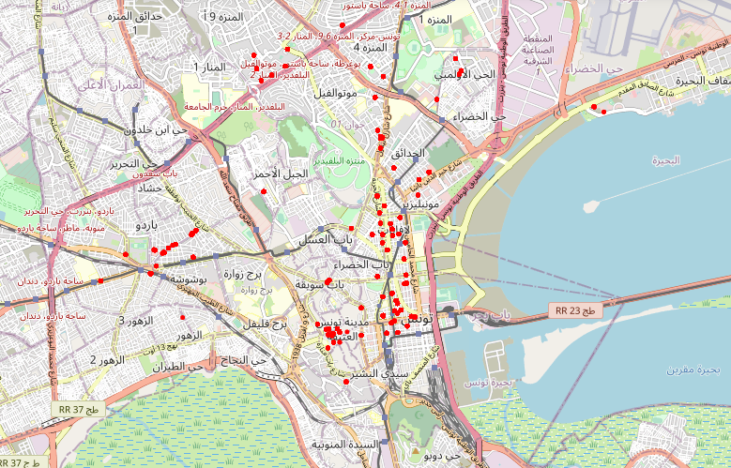
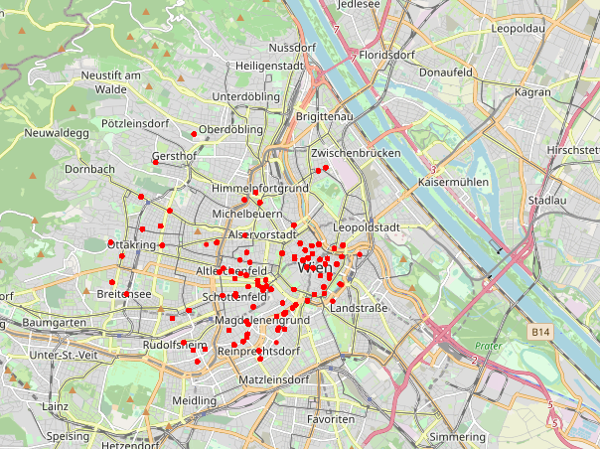
Food venues comparison
Tunis
Vienna

Slide 5
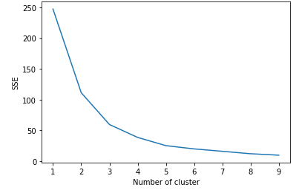
Calculating optimal number of clusters
Elbow Method: Squared-Root Sum of Error (SSE) vs Number of clusters
The point of inflection (the “elbow”) indicates the optimal number of clusters

Slide 6
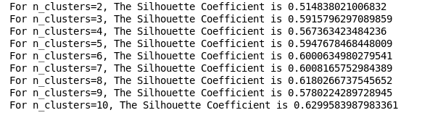
Calculating optimal number of clusters
Silhouette Coefficient score relates to a model with better-defined clusters.
=> Using both methods, we get optimal k = 3.

Slide 7
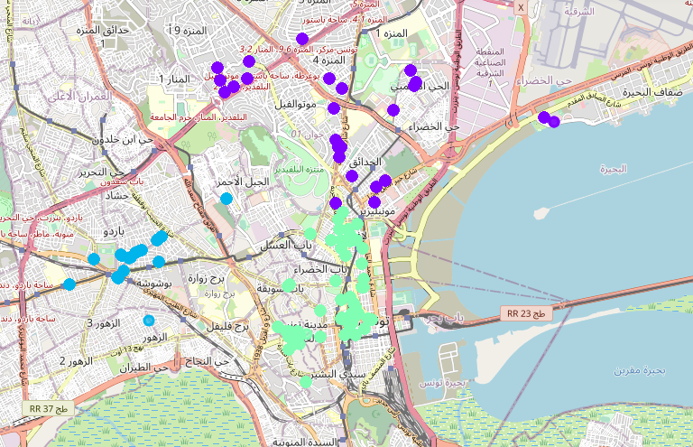
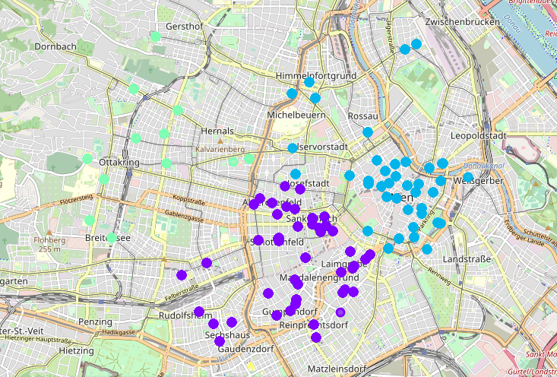
Visualizing Clusters
Tunis
Vienna

Slide 8
Results
Tunis
Vienna
1 big dense cluster in the center, and 2 smaller clusters located in the north and the west.
Gap zones with no food venues.
=> Easy acess to food venues in the center
2 big dense clusters in the center, and 1 smaller cluster in the west
=> Easy access to food everywhere

Slide 9
Conlusion
For a consumer :
Vienna provides easier access to food venues than Tunis
For an investor:
Tunis has more food store opportunities than Vienna (especially in the west and in the north)

